Slide 1
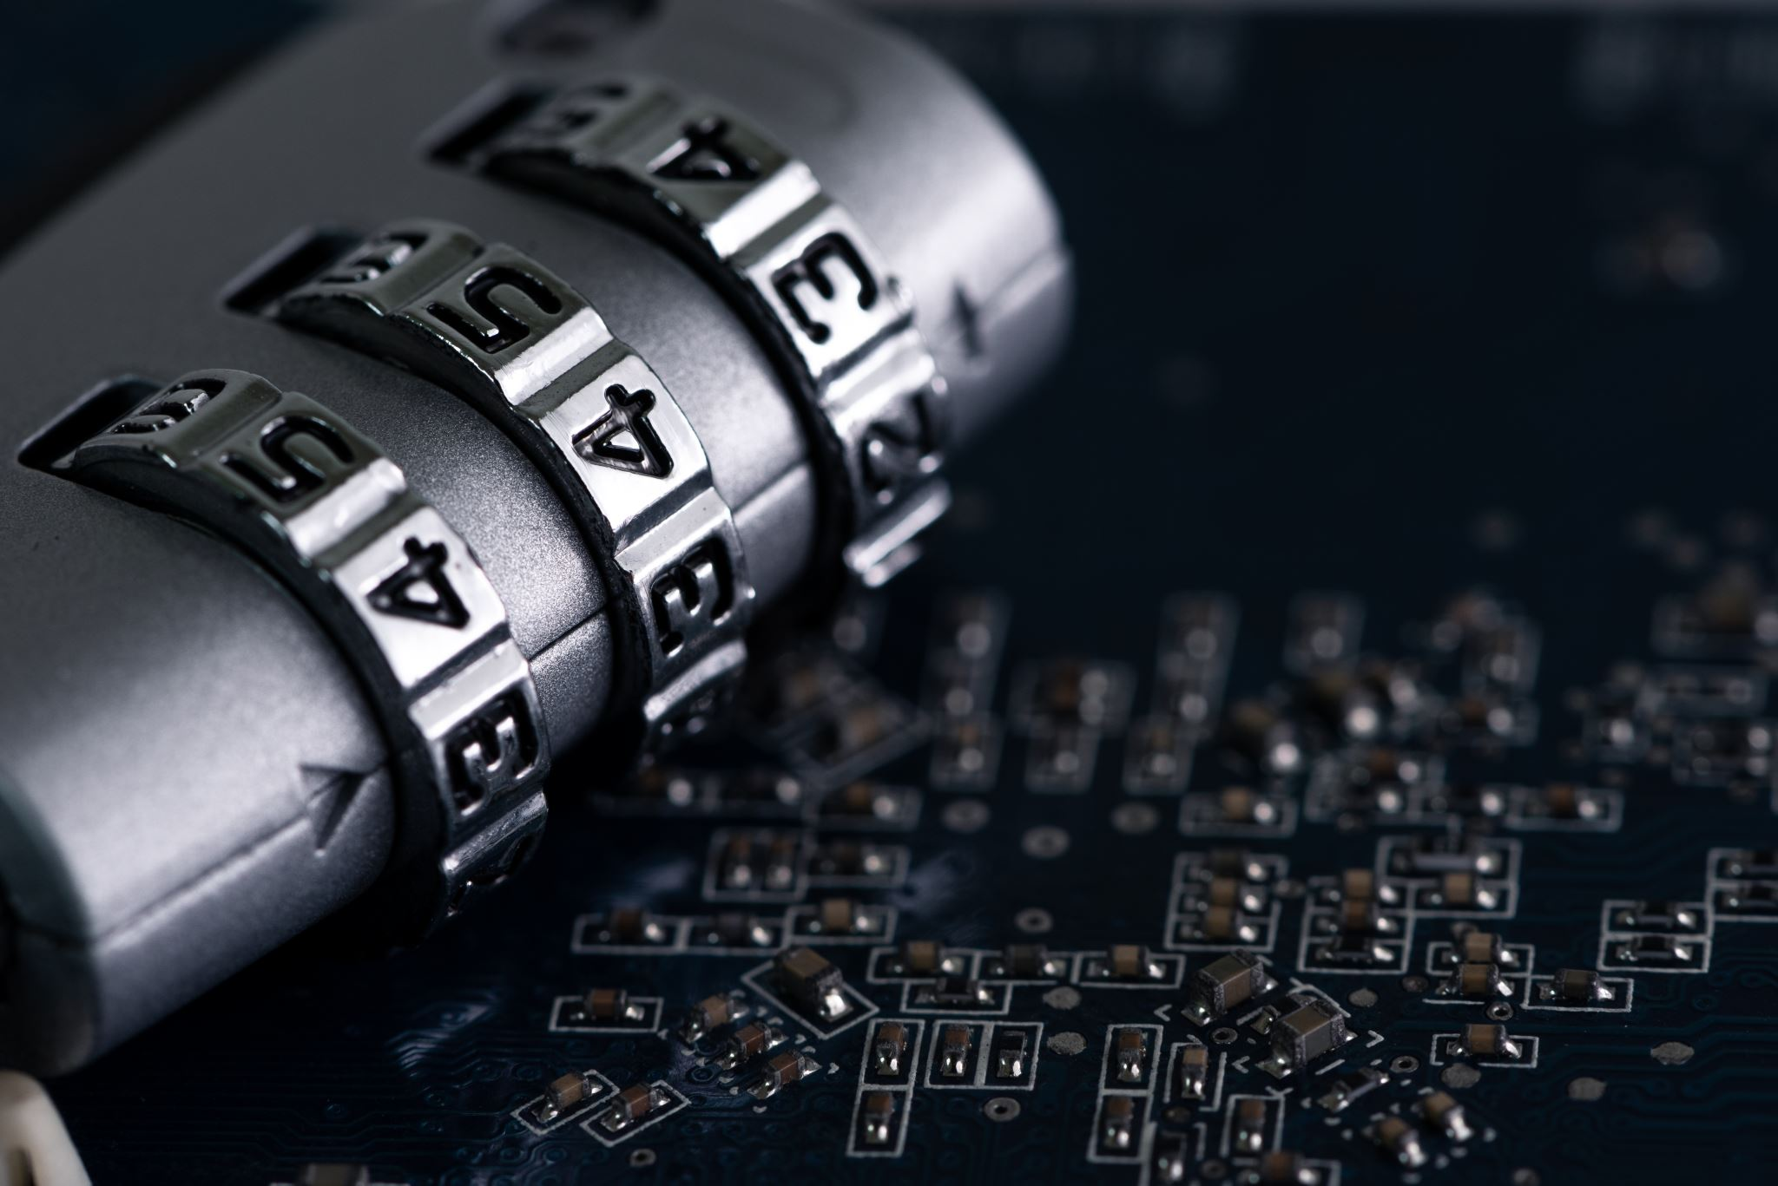
INTERNET SECURITY
(GUIDELINES TO STAYING SAFE ON THE INTERNET…)

Slide 2

WHAT IS THE INTERNET?
The internet is a big network of computers that are all connected. It's like a superhighway for information and communication. You can use it to do things like send emails, watch videos, and read news from anywhere in the world. It's a giant playground where you can explore, learn, and connect with others.

Slide 3
WHAT IS INTERNET SECURITY
Internet security is all about protecting your personal information and devices from people who try to steal or harm them.

Slide 4

WHY DOES internet security matters?
Without proper security measures, you could be vulnerable to various risks, including:
Identity Theft
Financial Loss
Privacy Breaches
Malware Infections

Slide 5
How do I stay safe on the internet?
Use Strong Passwords
Enable Two-Factor Authentication (2FA)
Keep Software Updated
Beware of Phishing Attempts
Use Secure Websites
BE CAREFUL WITH SOCIAL MEDIA

Slide 6
THE END!

